Slide 1
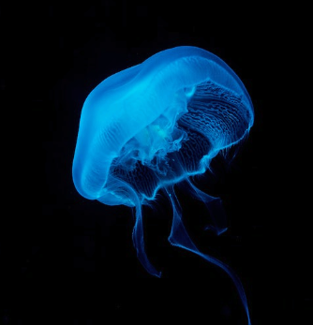
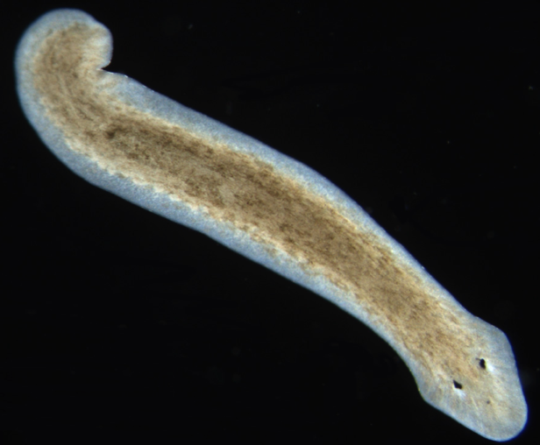
The Jellyfish and the Flatworm
A Story About Leading Artificial Intelligence
Dan McCreary
Version 3.1, Updated November 2023

Slide 2
Talk Description
Could an organization benefit from a centralized knowledge graph? The Jellyfish and the Flatworm is a story that decision makers can easily remember when they are thinking strategically about AI. This story helps them understand the tradeoffs when building centralized knowledge repositories that power their current and future AI systems.
Our goal is to have leaders recall this story about how knowledge representation is a critical factor of AI and intelligent agents. How we model the world can make or break a company. Knowledge Graphs are a foundation for predication. They also become force multipliers to help the productivity of knowledge workers.

Slide 3

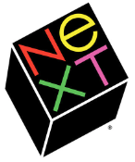
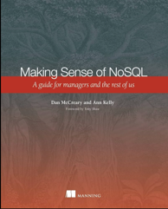


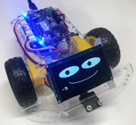


Background for Dan McCreary
Solution architect with over 35 years working with data
Worked for Bell Labs and Steve Jobs at NeXT
Author of a book on database selection, “Making Sense of NoSQL”
Promoter of graph query standards (ISO GQL)
Former Distinguished Engineer working for Optum (UHG)
Built the world’s largest healthcare knowledge graph
Led the “Generative AI Center of Excellence” at Optum
Worked with over 250 healthcare uses cases – 50 of which were funded and over 10 in production
Blogger: http://medium.com/@dmccreary
Big fan of AI, robotics, MicroPython, and STEM education
Advocate for neurodiversity

Slide 4
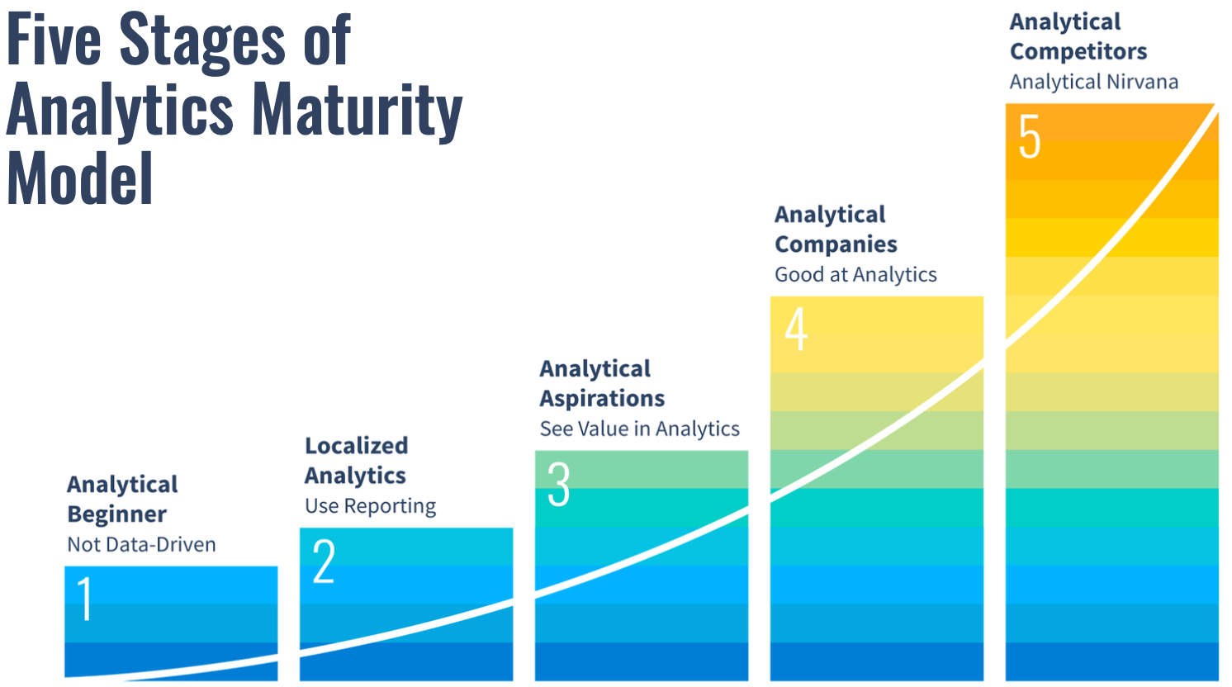
Accelerating Movement from 2 to 3

Slide 5
Jellyfish
Jellyfish live in a relatively “simple” environment of the open ocean
Their food must float into their tentacles
Jellyfish don’t need a complex brain to float around in the ocean
Their simple surroundings mean they don’t need to learn to traverse complex landscapes
Their nervous system is spread throughout their body

Slide 6

Flatworms
Flatworms on the other hand live in a relatively “complex” environment
They crawled to the bottom of the ocean to seek food and avoid hazards
Flatworms were one of the first animals to have a central nervous system (CNS)
A CNS has benefits over the distributed nervous system of a jellyfish
CNS evolved to hold a “map” of the world around them
Flatworms were the first “hunters”

Slide 7
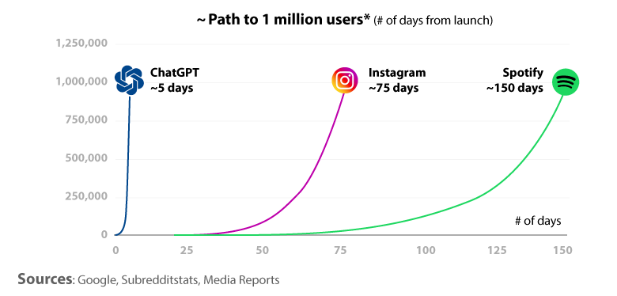
The Rise of Large Language Models
In 2022 we saw the incredible rise of ChatGPT and the growth of large language models
ChatGPT reached over 1 million users in just five days and over 100M users in just a few weeks
But will these large language models (LLMs) alone help us serve our customers?

Slide 8
Innovation Zone
The
Innovation
Zone
Large
Language
Models
Knowledge
Graphs
Models of the real world
A model of langauge

Slide 9

The Knowledge Representation Hypothesis (KRH)
Organisms that build accurate “models” of the world around them may have a competitive advantage
The benefits of the model must outweigh the costs of building the model
The benefits of building a model
The cost of building a model

Slide 10
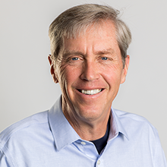
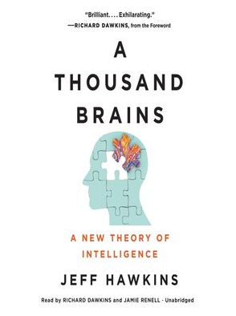
Jeff Hawkins Quote
“The key to artificial intelligence has always been the representation.”
https://towardsdatascience.com/1000-brains-and-the-ekg-8ef7b1764ccd

Slide 11
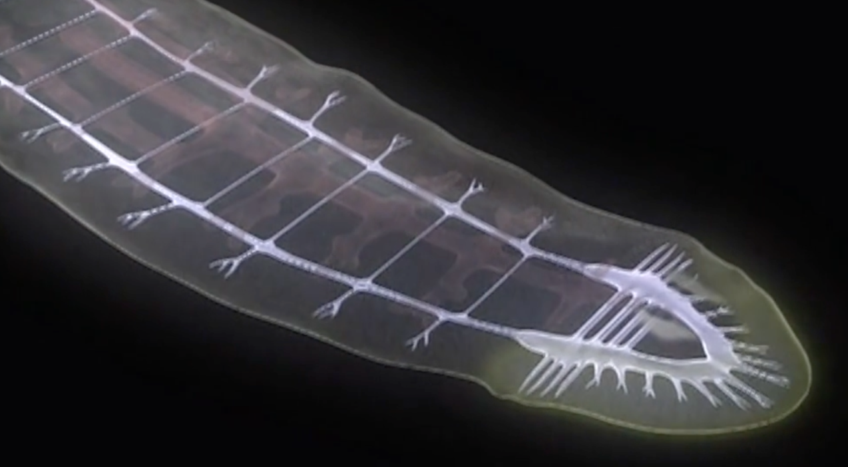

A Thought Experiment
What can you put in a brain? Simple rules? Models?

Slide 12
Imagine Two Flatworms
Poor model
Better model
Wanders around aimlessly
Rarely finds food
Runs into predators
Short lifespan
Precise navigation in their world
Ability to navigate to food
Avoids predators
Longer lifespan

Slide 13
Imagine Two Organizations
Poor model
Better model
Product design is random
Rarely finds new customers
Competitors outmaneuver your products
Low growth
Precise matching of products to customers needs
Ability to quickly add new features
Avoids competition by predicting customer needs
Faster growth

Slide 14

Can We Extend the KRH from Animals to Organizations?
What would a “model” of our organization look like?
Would it include:
Our customers?
Our products?
Our competition?
What tools do we have to model the real world?
Excel?
CSV Files?
RDBMS?
A knowledge graph?

Slide 15
Do You Work for a Jellyfish Company?
You only sell a single product
You only have a single customer
You don’t have any competition
Your industry is static and does not change over time
Customers
Products
Competition

Slide 16
Do You Work for A Flatworm Company?
You sell many products
You have many customers
Your products have many competitors
Your competitors are using technology to introduce new products
Customers
Products
Competition

Slide 17
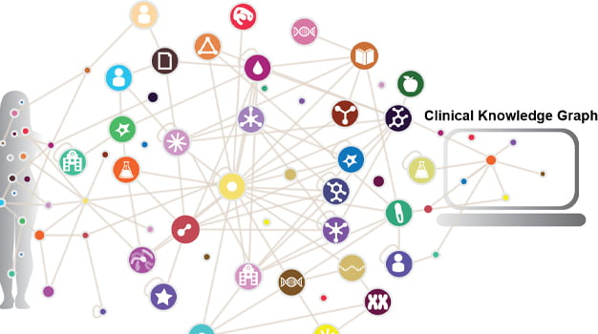
A Graph Models Complexity
Analysts
Dashboards
Customer
Products
Competition
Customer Touchpoints

Slide 18

KRH Corollary
Organizations that build accurate models of the world around them have a competitive advantage and will grow faster as long as the value of creating and maintaining these models exceeds their costs.

Slide 19
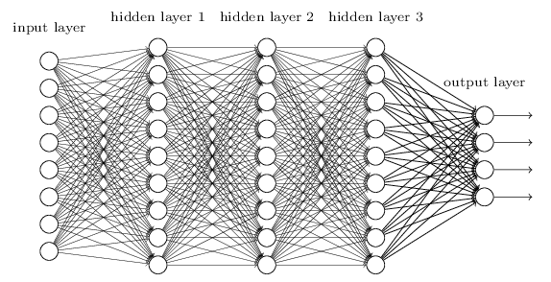
Deep Neural Networks
Deep Neural Networks are similar – but very different from – the human brain. We need “reference frames.”

Slide 20
Challenges with Deep Neural Networks
Knowledge is dispersed over the entire network
Probabilistic reasoning: no guarantees of correctness
Extremely low explainability (why did you make that recommendation)
It can be very expensive to train LLMs ($100M)
No way to remove an incorrect fact

Slide 21
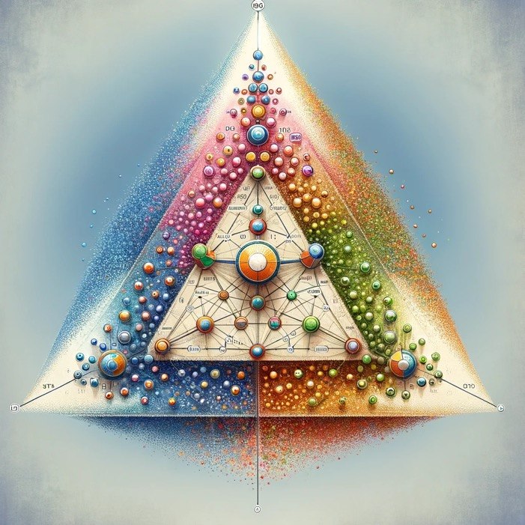
Analyst Workflows Today
Get requirements
Source the data
Understand the data
Clean the data
Remove the duplicate from the data
Join the data
Create a model
Run the model
Present a report with insights
Delete everything

Slide 22
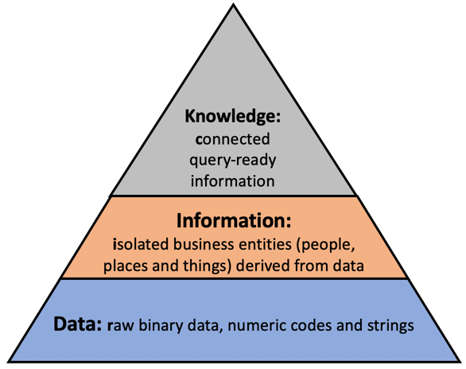
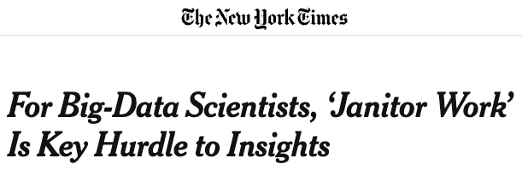
Challenges of Data Engineer-Focused Approach
80% of effort is low-level data engineering “Data Janitor Work”
Very little focus on building reusable assets
Every project is a “one-off” project
No consideration given to future reuse of knowledge
Difficult to estimate time and costs

Slide 23
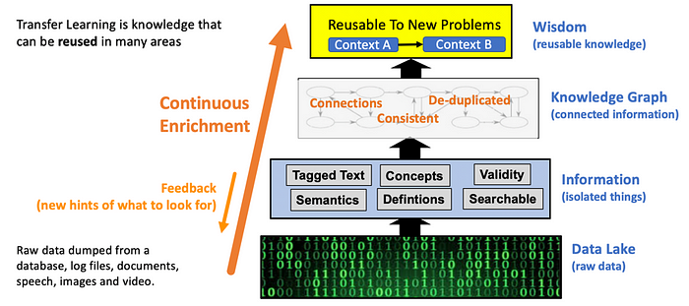
Knowledge Engineering

Slide 24
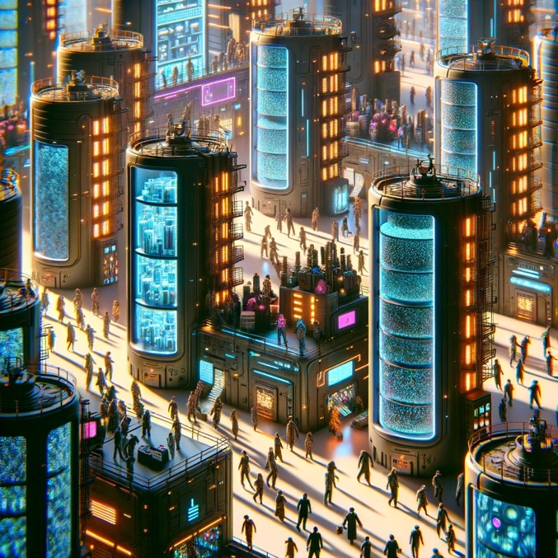
Challenges of Adopting a Knowledge Graph
Information is siloed in many databases and proprietary applications
Individual analysts access the data, do some analysis, create a presentation, and throw the knowledge away
Low reproducibility and no incentives to make the knowledge more accessible to future analysts

Slide 25
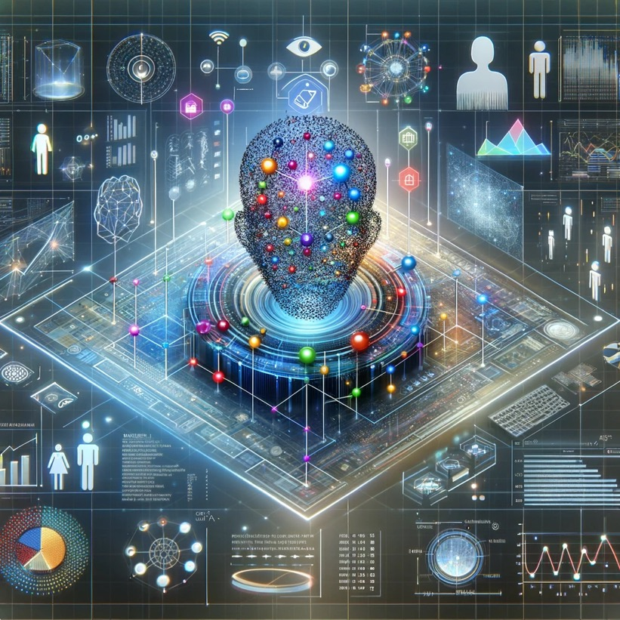
Customer Data Is Everywhere
Sale prospecting
Customer orders
Call center logs
Call center transcripts
Customer visits to website
Customer searches
Customer surveys
Customer returns
Social media comments

Slide 26
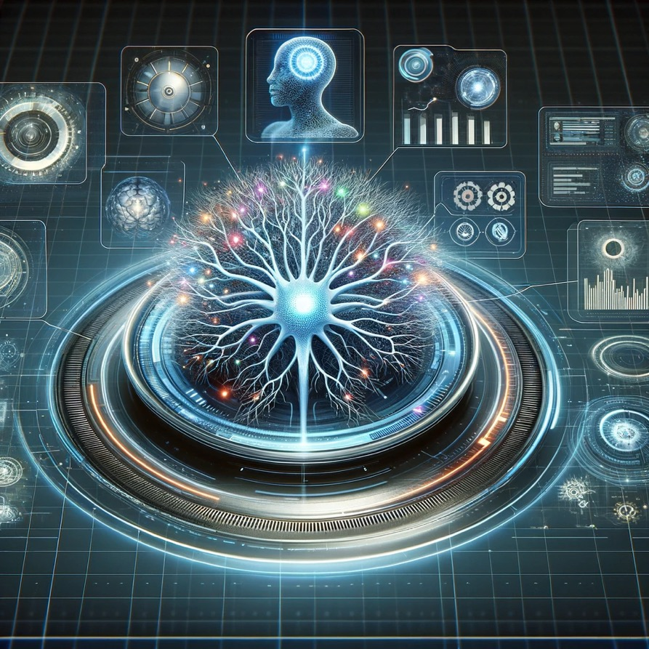
The Graph Is the Organization
A central knowledge graph will become foundation that AI agents run on
Agents continually gather new knowledge and store in ways that future agents can benefit – reuse!
Both knowledge and algorithms will be embedded in the centralized knowledge graph

Slide 27
Accelerating Movement from 2 to 3

Slide 28
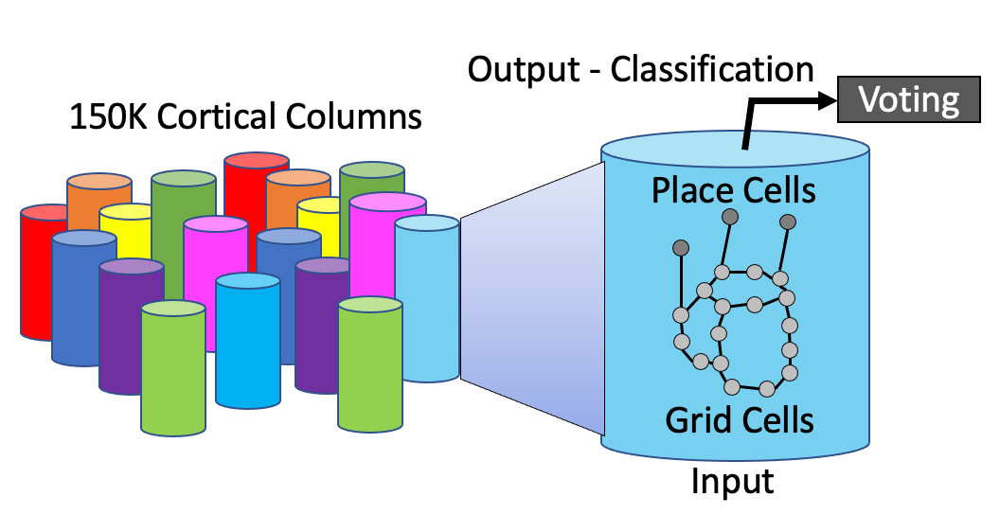
A Thousand Brains Theory
https://towardsdatascience.com/1000-brains-and-the-ekg-8ef7b1764ccd

Slide 29
Summary
Large language models are not sufficient for us to model the world
Knowledge graphs are not sufficient to bring in complex data and allow users to ask English language questions of systems
By combining large language models with knowledge graphs, we can build intelligent systems that have a holistic view of our organizations
Knowledge
Graphs
Innovation
Zone
LLMs

Slide 30
Call to Action!!
We need:
Visionary thought leadership
Drawing clear pictures of the future and maps with paths to get us there
Tell stories that our leaders can remember
Empathy for our members, agents, providers and customers
If we can’t model it, we can’t understand it
Willingness to let go of simple models that don’t serve our customers
Knowledge transfer to our future engineers
Knowledge graphs
Generative AI
Teach IT leadership using accurate simulations

Slide 31

Thank You!
Questions
https://www.linkedin.com/in/danmccreary

